Slide 1

Network Machine Learning Graph-based EEG Analysis Project
Veit Weidinger
Manuel Westermann
Maximilian Spannring
Elias Panner
Group 13
Spring Semester 2025
Notes:
Elias

Slide 2
Outline
Dataset Details
Approaches:
GNN → Bi-directional LSTM
EEGNet
EEGNet + Transformer
NeuroGNN
Results
Notes:
Elias

Slide 3
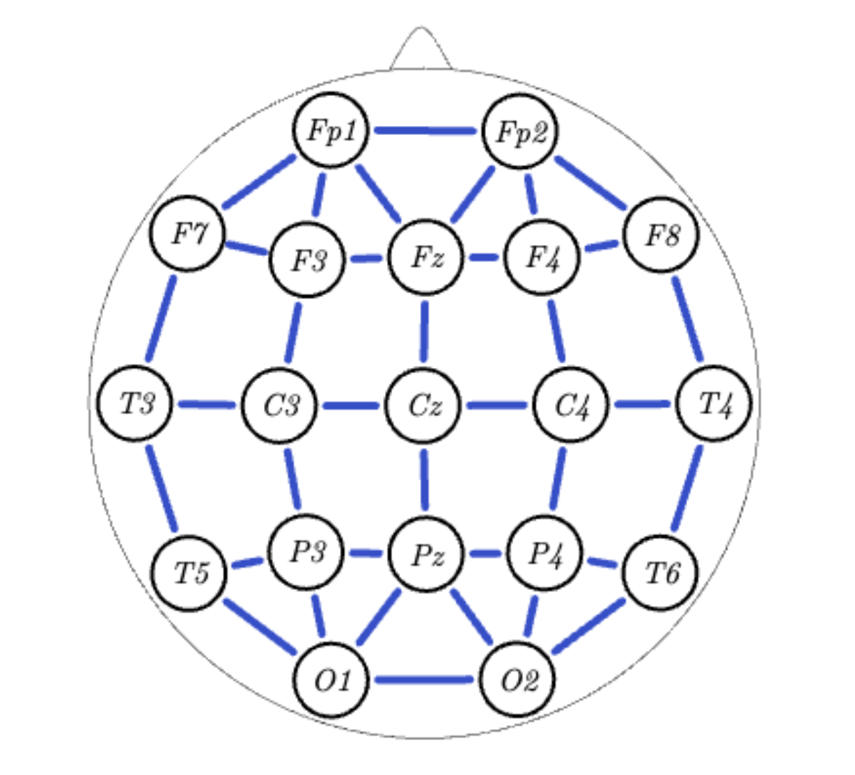
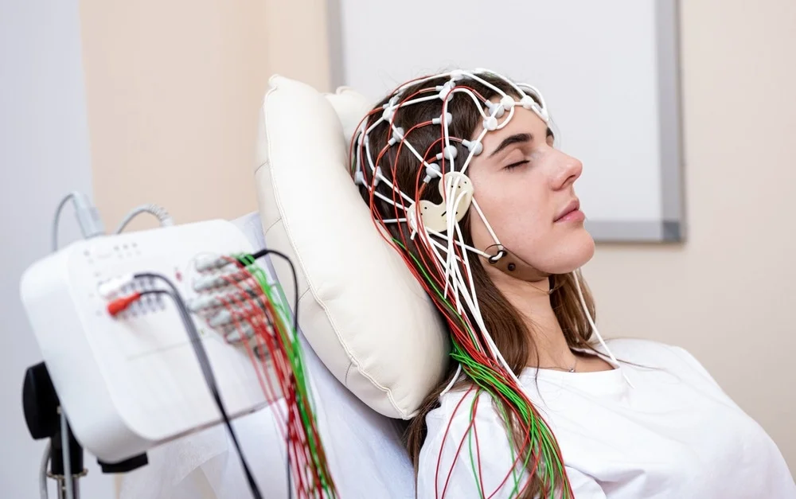

Dataset Details
Temple University Hospital EEG Seizure Corpus (TUSZ)
75 patients (50 train / 25 test)
Multiple EEG sessions per patient
19 electrodes per measurement (250Hz)
10-20 system
Image Credit: Roman Zaiets/Shutterstock.com Source: Thanou, D., & Frossard, P. (2025). Graph-based EEG analysis [Project proposal]. EE-452: Network Machine Learning, EPFL.
Notes:
Elias

Slide 4
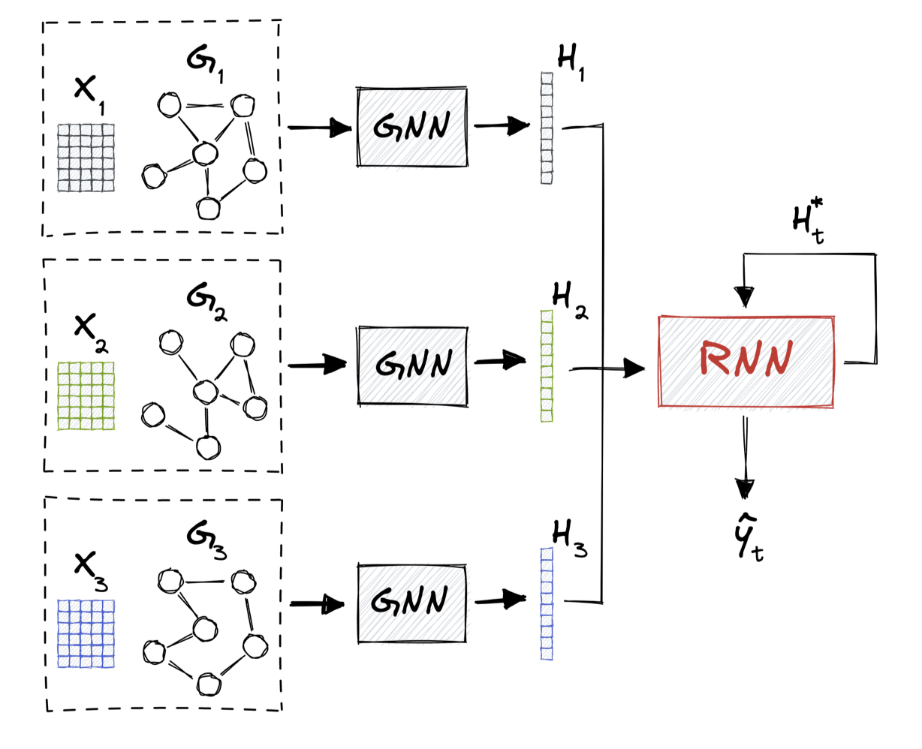


GNN → Bi-directional LSTM
Spatial, then temporal: Node embeddings for each time step are fed to a temporal model
Source: Thanou, D., & Frossard, P. (2025). Graph neural networks: Advanced topics & applications (Slide 24). EE452 – Network Machine Learning. École Polytechnique Fédérale de Lausanne.
Notes:
Elias
First approach: Spatial, then temporal (from the lecture)
19 heads for 1 point in time
Preprocessing with Fourier Transformation
For the GNN, we took GCN.
Then: xLSTM (for the RNN, we took Bi-LSTM)

Slide 5
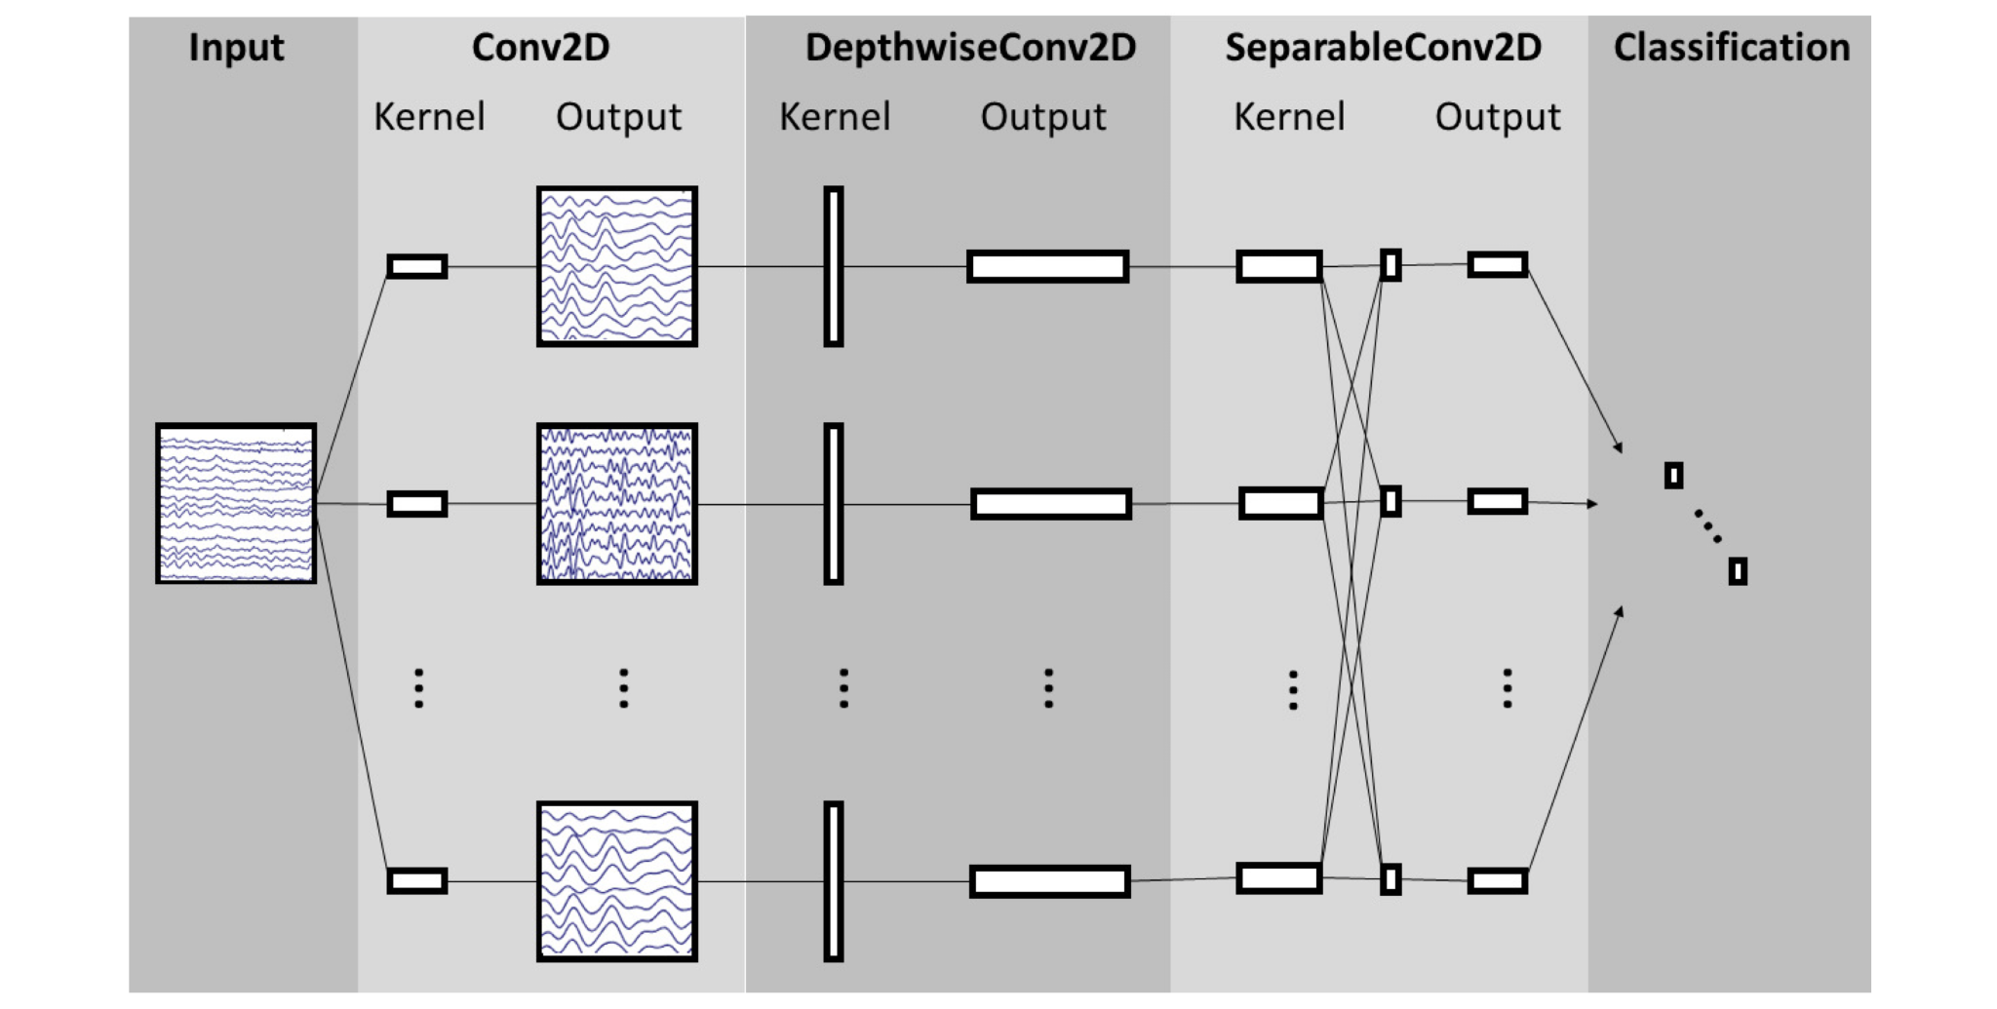
EEGNet
Source: Lawhern, V. J., Solon, A. J., Waytowich, N. R., Gordon, S. M., Hung, C. P., & Lance, B. J. (2018). EEGNet: A compact convolutional neural network for EEG-based brain–computer interfaces. Journal of Neural Engineering, 15(5), 056013. https://doi.org/10.1088/1741-2552/aace8c
Notes:
Max
Lightweight architecture, suitable for deployment on mobile devices/ environments with limited ressources
Consists of three layers:
2d convolutional filter which basically performs bandpass filtering at half the sample rate and thus capturing the relevant frequency bands.
After that, a depthwise 2d convolution is applied. This enables the model to learn the spatial relationship between the nodes.
At the end, the output is combined with a seperable convolution.
Additionally, batch normalization is applied to ensure stability and an exponential linear unit is used to add some nonlinearity to the model.

Slide 6
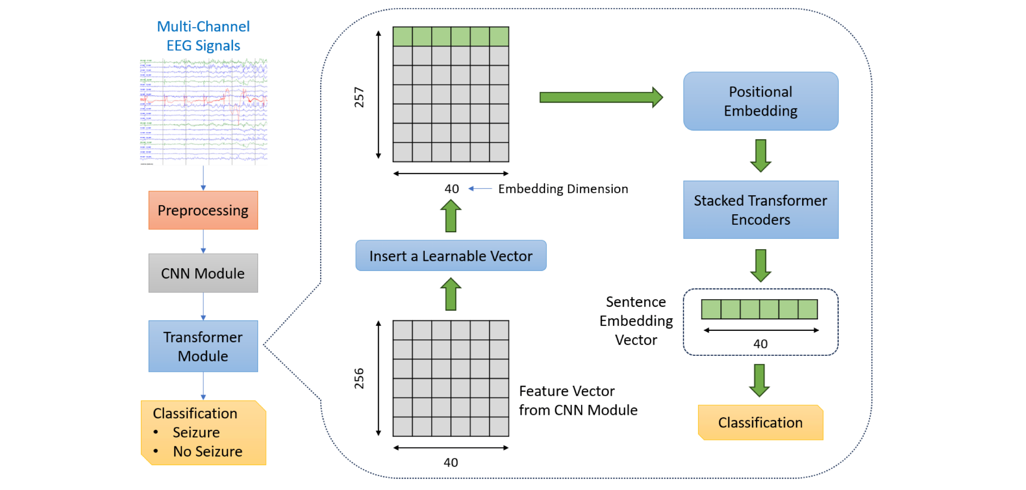
EEGNet + Transformer
Source: Zhu, Y., & Wang, M. D. (2023). Automated seizure detection using transformer models on multi-channel EEGs. Proceedings of the IEEE EMBS International Conf. on Biomedical and Health Informatics (BHI 2023), 1–8. https://github.com/UnitedHolmes/seizure_detection_EEGs_transformer
Notes:
Max
Next step: extending the eegnet with a transformer
Hybrid approach: combining the EEGnet with a transformer
Best results, also a very good generalization
Transformer captures long-term seizure evolution patterns that CNN alone would miss
Treats feature maps as tokens: Learns which frequency-spatial combinations matter most

Slide 7
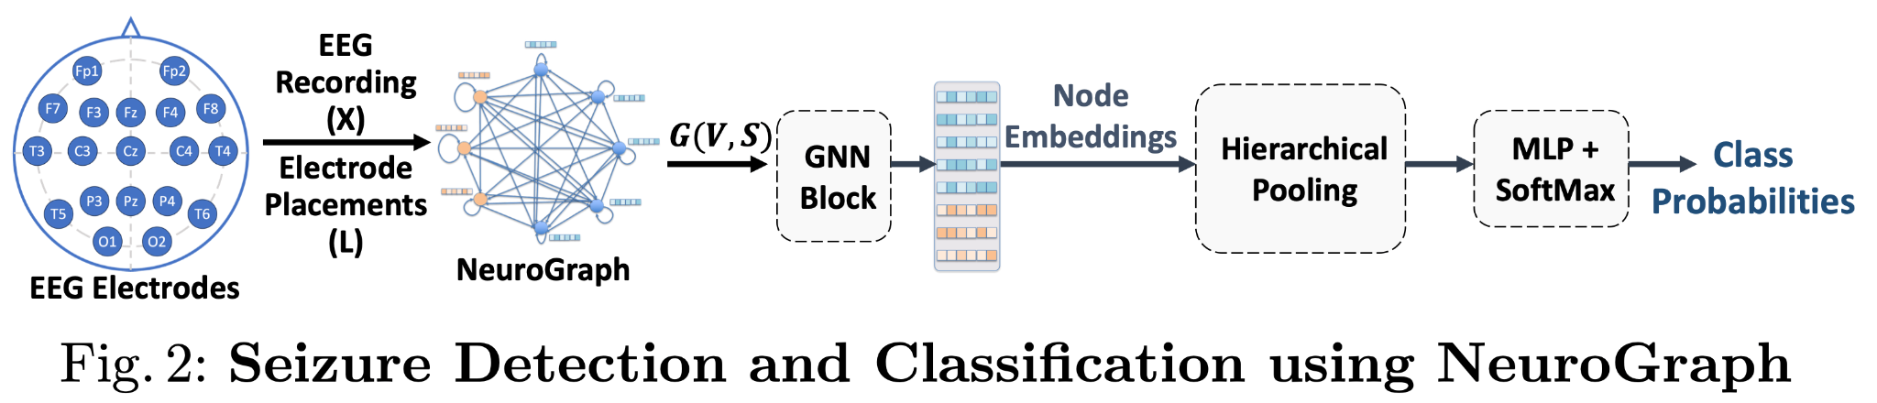
NeuroGNN
Source: Hajisafi, A., Lin, H., Chiang, Y.-Y., & Shahabi, C. (2024). Dynamic GNNs for precise seizure detection and classification from EEG data. In Advances in Knowledge Discovery and Data Mining (pp. 207–220). Springer Nature Singapore. https://doi.org/10.1007/978-981-97-2238-9_16
Notes:
Manuel

Slide 8
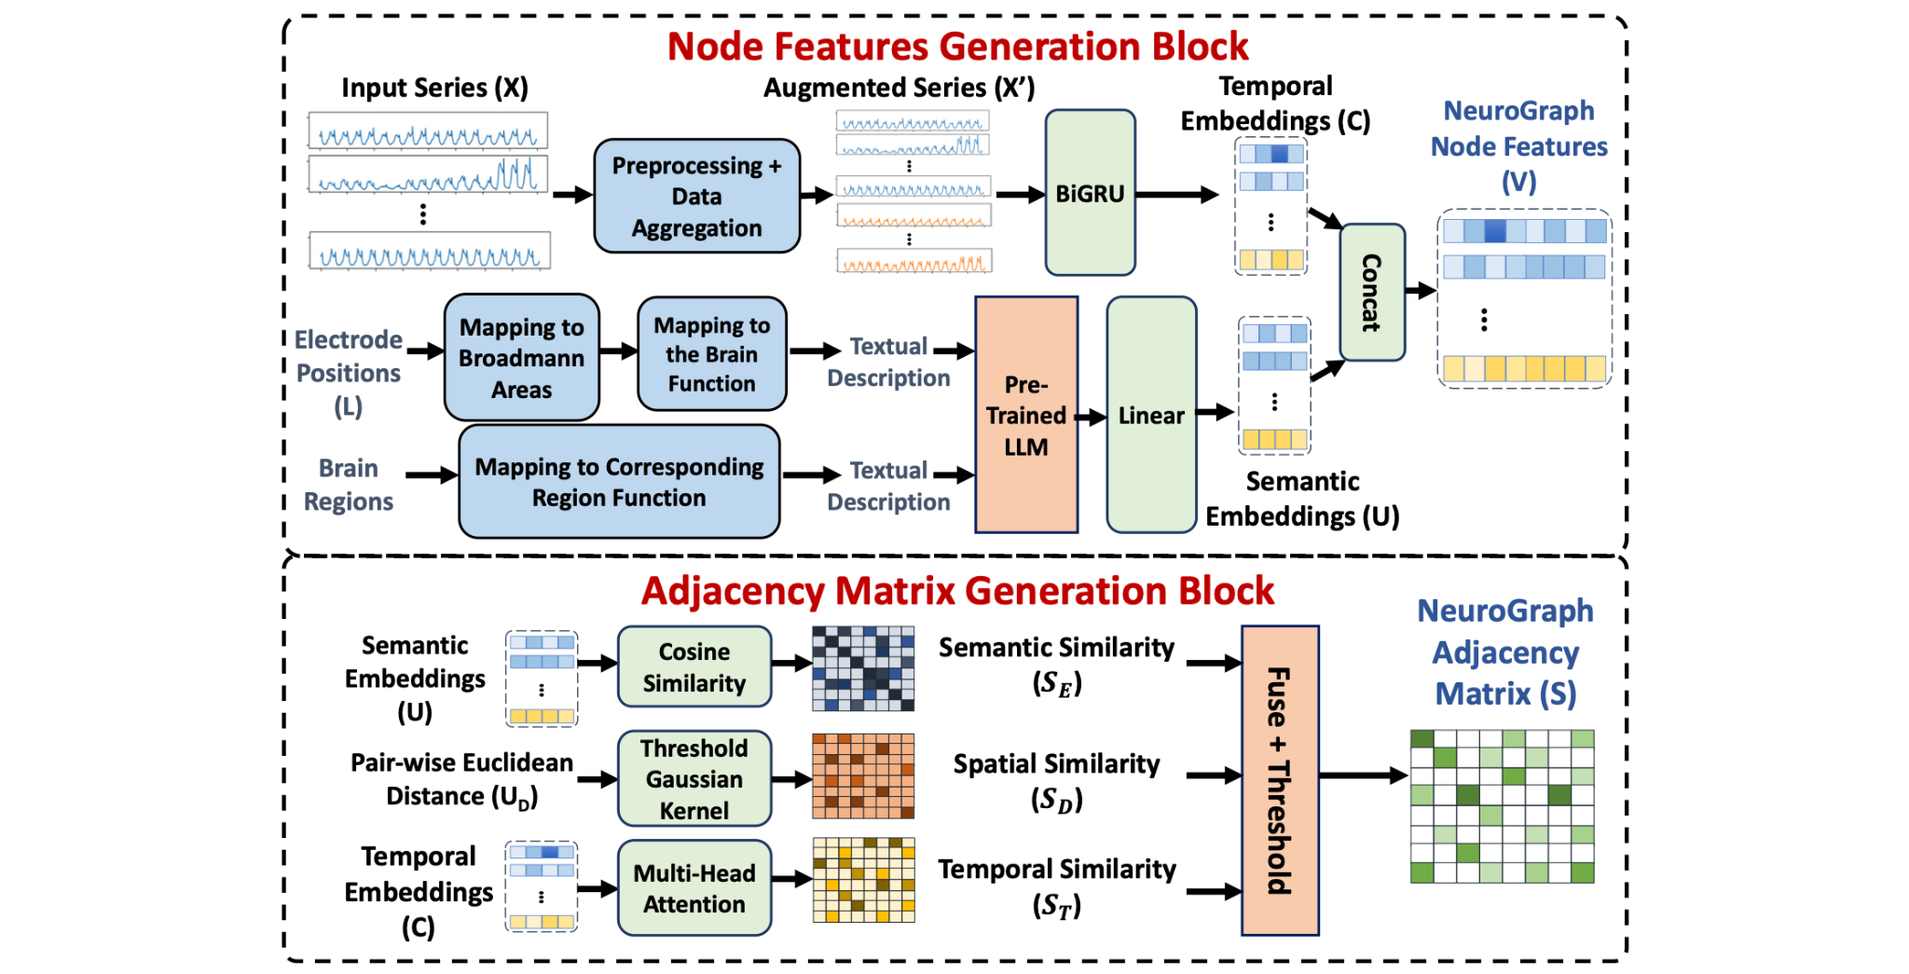
NeuroGNN
Source: Hajisafi, A., Lin, H., Chiang, Y.-Y., & Shahabi, C. (2024). Dynamic GNNs for precise seizure detection and classification from EEG data. In Advances in Knowledge Discovery and Data Mining (pp. 207–220). Springer Nature Singapore. https://doi.org/10.1007/978-981-97-2238-9_16
Notes:
Manuel

Slide 9
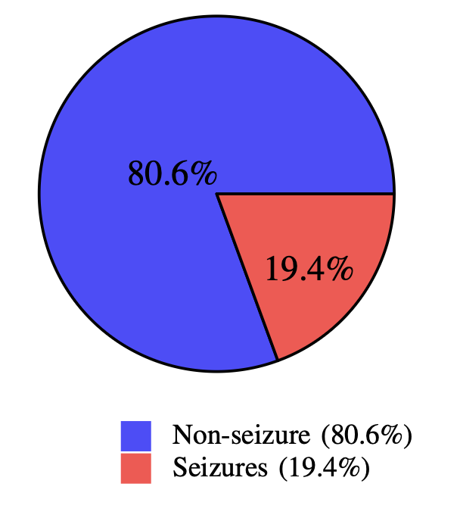
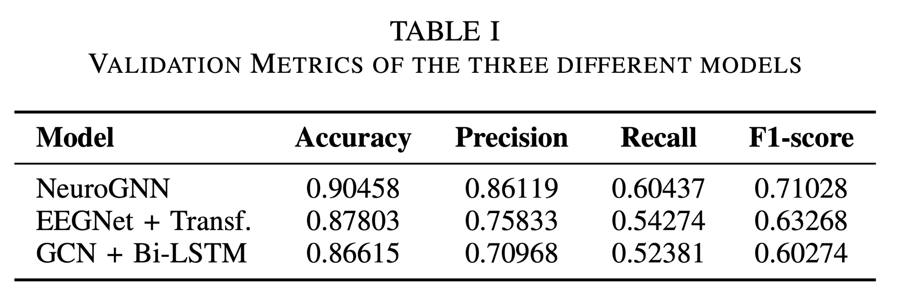
Results on Validation-Split
Source: Panner, E., Weidinger, V., Westermann, M., & Spannring, M. (2025). Graph-based and deep learning models for EEG seizure detection [Course project report, EPFL]. Network Machine Learning, Spring Semester 2025.
Notes:
Veit

Slide 10
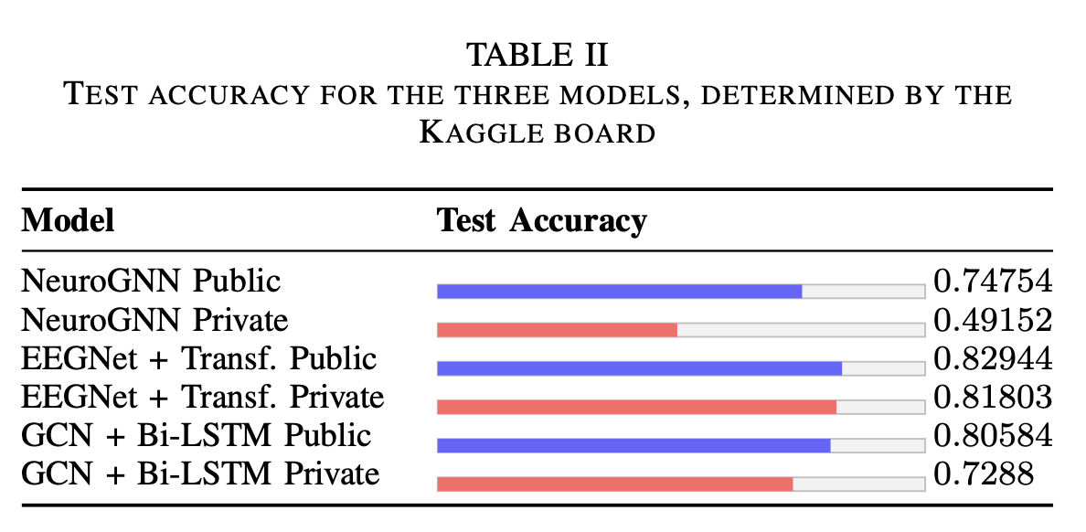
Accuracy on Test Data
Source: Panner, E., Weidinger, V., Westermann, M., & Spannring, M. (2025). Graph-based and deep learning models for EEG seizure detection [Course project report, EPFL]. Network Machine Learning, Spring Semester 2025.
Notes:
Veit

Slide 11
Q&A Part
Looking forward to a fruitful discussion.
Notes:
Veit

Slide 12
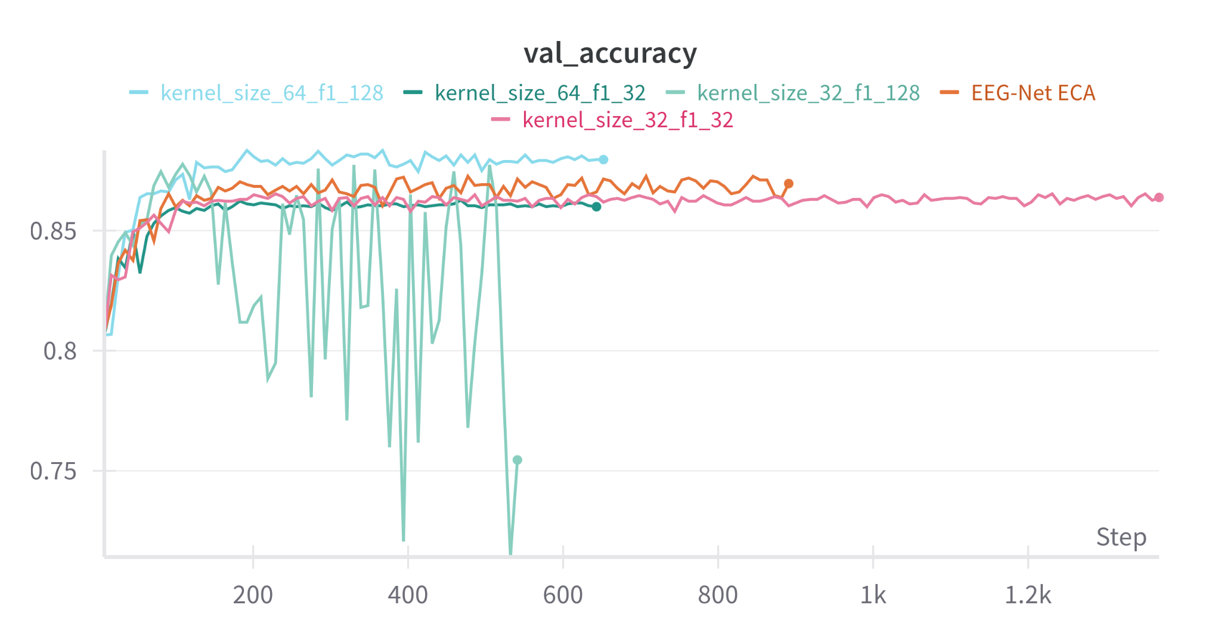
Additional: Sweeps
Notes:
Max

Slide 13
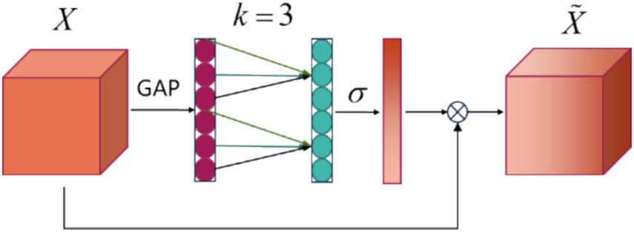
Additional: Efficient Channel Attention
Image credit: Attention-based multiscale EEGNet for effective motor imagery EEG decoding,” Frontiers in Neurorobotics, vol. 19, 2025.
Notes:
Max

Slide 14
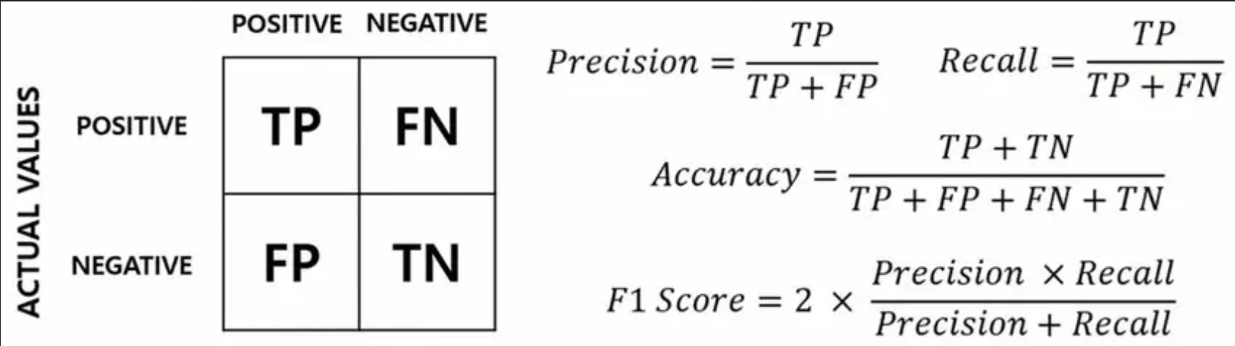
Additional: Metrics
Image credit: Aymane Chilah/ Johnsnowlabs
Notes:
Max

